Slide 3
Level 1: One Hand
Level 2: Two Hands - Middle C Position Notes
Level 3: Two Hands – C & Middle C Position Notes

Slide 6
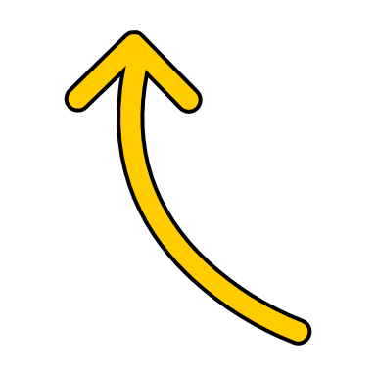
No Skips
No Skips
3
2

Slide 7
No Skips
No Skips
2
1

Slide 8
No Skips
No Skips
5
4

Slide 9
No Steps
No Steps
4
1

Slide 10
No Skips
No Steps
2
1

Slide 11
No Steps
No Steps
2
1

Slide 12
No Skips
No Steps
5
2

Slide 13
No Steps
No Steps
3
2

Slide 16
No Skips
No Skips
3
2
1
2

Slide 17
No Skips
3
4
1
5

Slide 18
No Steps
3
4
1
3

Slide 19
No Steps
No Steps
1
2
2
1

Slide 22
No Skips
2
2
2
4

Slide 23
No Skips
No Skips
5
3
5
5

Slide 24
No Skips
No Skips
4
3
3
3

Slide 25
No Steps
2
2
2
4

