Slide 1
Staff Stuff
Line Or Space?
Which Clef?
Which Line?
Bar Lines
Which Space?
The Grand Staff
The Alphabet

Slide 3
SPACE NOTE
LINE NOTE
LINE NOTE

Slide 4
SPACE NOTE
SPACE NOTE
LINE NOTE

Slide 5
SPACE NOTE
LINE NOTE
LINE NOTE

Slide 6
LINE NOTE
SPACE NOTE
LINE NOTE

Slide 8
LINE 4
LINE 2
LINE 5

Slide 9
LINE 1
LINE 4
LINE 3

Slide 10
LINE 3
LINE 1
LINE 4

Slide 11
LINE 2
LINE 4
LINE 1

Slide 13
SPACE 1
SPACE 4
SPACE 2

Slide 14
SPACE 3
SPACE 2
SPACE 4

Slide 15
SPACE 4
SPACE 1
SPACE 3

Slide 16
SPACE 2
SPACE 3
SPACE 1

Slide 18
F
BASS CLEF
=
F CLEF

Slide 19
G
TREBLE CLEF
=
G CLEF

Slide 20
G
TREBLE CLEF
=
G CLEF

Slide 21
F
BASS CLEF
=
F CLEF

Slide 23
3

Slide 24
2

Slide 25
2
Repeat Sign

Slide 26
3
Double Bar Line

Slide 28
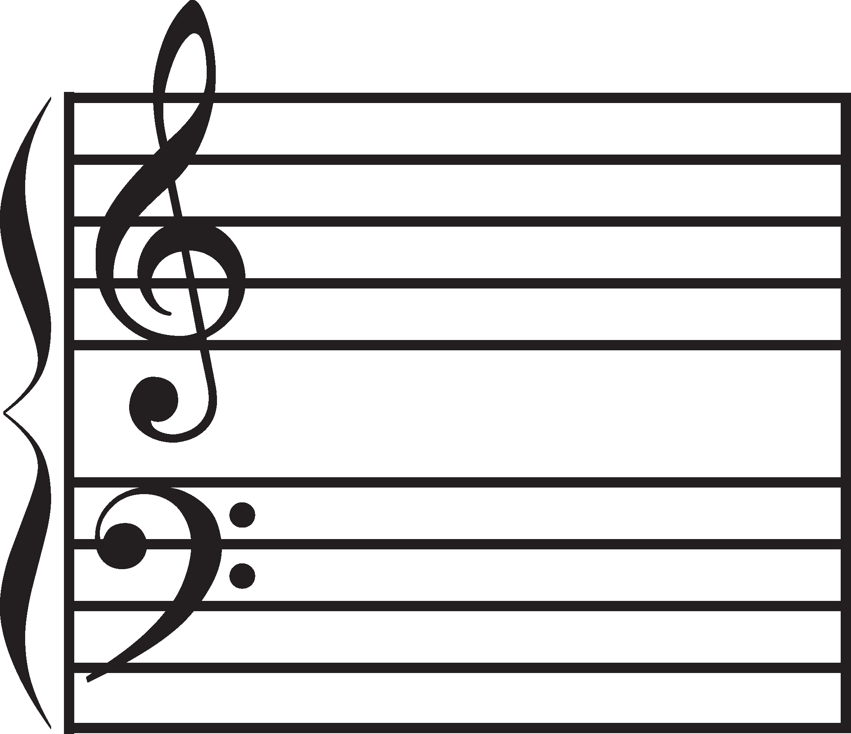
The Grand Staff
Treble Staff
Curly Brace & Bar Line
Bass Staff

Slide 29
Music Alphabet

Slide 30
There are 7 letters in the Music Alphabet.
A B C D E F G
Since we can go down the notes as well as up, we need to know the music alphabet backwards too.
G F E D C B A

Slide 31
Let’s Say The Music Alphabet Backwards.
G
F
E
D
C
B
A

Slide 32
Let’s Say The
Music Alphabet Backwards again.
G
F
E
D
C
B
A

Slide 33
Treble Clef / G Clef
G
F
E
D
C
B
A
G
F
E
D
G Line

Slide 34
Work out the name of this note:
E
G

Slide 35
Work out the name of this note:
C
G

Slide 36
Work out the name of this note:
G
D

Slide 37
Work out the name of this note:
F
G

Slide 38
Work out the name of this note:
B
G

Slide 39
Work out the name of this note:
G
E

Slide 40
Bass Clef / F Clef
B
A
G
F
E
D
C
B
A
G
F
F Line

Slide 41
Work out the name of this note:
F
D

Slide 42
Work out the name of this note:
B
F

Slide 43
Work out the name of this note:
F
A

Slide 44
Work out the name of this note:
F
C

Slide 45
Work out the name of this note:
F
G

Slide 46
Work out the name of this note:
A
F

Slide 47
YAY!
PRACTICE MAKES PROGRESS ☺

